Slide 1
CSCE 5580 – Computer Networks
Midterm Review
Instructor: Tao Wang

Slide 2

Topics
Network core: packet/circuit switching, internet structure
Performance: loss, delay, throughput
Protocol layers, service models
Principles of network applications
Web and HTTP
The Domain Name System DNS
E-mail, SMTP, IMAP
P2P applications
Connectionless transport: UDP
Principles of reliable data transfer
Connection-oriented transport: TCP
TCP congestion control

Slide 3
















The network core
mesh of interconnected routers
The fundamental question: how is data transferred through the network?
  Circuit-switching: continuous and dedicated
  Packet-switching: chunks of data and discrete
mobile network
national or global ISP
local or regional ISP
home network
content
provider
network
datacenter
network
enterprise
network

Slide 4

How do packet delay and loss occur?
packets queue in router buffers, waiting for turn for transmission
  queue length grows when arrival rate to link (temporarily) exceeds output link capacity
packet loss occurs when memory to hold queued packets fills up
packet being transmitted (transmission delay)
A
B
packets in buffers (queueing delay)
free (available) buffers: arriving packets
dropped (loss) if no free buffers

Slide 5
Packet delay: four sources
transmission
A
propagation
B
nodal
processing
queueing
d_{nodal} = d_{proc} + d_{queue} + d_{trans} + d_{prop}
d_{proc}: nodal processing
check bit errors
determine output link
typically < microsecs
d_{queue}: queueing delay
time waiting at output link for transmission
depends on congestion level of router

Slide 6
Packet delay: four sources
transmission
A
propagation
B
nodal
processing
queueing
d_{nodal} = d_{proc} + d_{queue} + d_{trans} + d_{prop}
d_{trans}: transmission delay:
L: packet length (bits)
R: link transmission rate (bps)
d_{trans} = L/R
d_{prop}: propagation delay:
d: length of physical link
s: propagation speed (~2x10⁸ m/sec)
d_{prop} = d/s
d_{trans} and d_{prop}
very different

Slide 7
Throughput
throughput: rate (bits/time unit) at which bits are being sent from sender to receiver
  instantaneous: rate at given point in time
  average: rate over longer period of time
link capacity
R_{s} bits/sec
link capacity
R_{c} bits/sec
pipe that can carry
fluid at rate
(R_{s} bits/sec)
pipe that can carry
fluid at rate
(R_{c} bits/sec)
server sends bits
(fluid) into pipe
server, with
file of F bits
to send to client

Slide 8
Throughput
R_{s} < R_{c} What is average end-end throughput?
R_{s} bits/sec
R_{c} bits/sec
R_{s} > R_{c} What is average end-end throughput?
R_{s} bits/sec
R_{c} bits/sec
bottleneck link
link on end-end path that constrains end-end throughput

Slide 9
Why layering?
Approach to designing/discussing complex systems:
explicit structure allows identification, relationship of system’s pieces
  layered reference model for discussion
modularization eases maintenance, updating of system
  change in layer's service implementation: transparent to rest of system
  e.g., change in gate procedure doesn’t affect rest of system

Slide 10
Layered Internet protocol stack
application: supporting network applications
  HTTP, IMAP, SMTP, DNS
transport: process-process data transfer
  TCP, UDP
network: routing of datagrams from source to destination
  IP, routing protocols
link: data transfer between neighboring network elements
  Ethernet, 802.11 (WiFi), PPP
physical: bits “on the wire”
application
application
transport
transport
network
network
link
link
physical
physical

Slide 11
Client-server paradigm
server:
always-on host
permanent IP address
often in data centers, for scaling
clients:
contact, communicate with server
may be intermittently connected
may have dynamic IP addresses
do not communicate directly with each other
examples: HTTP, IMAP, FTP
mobile network
national or global ISP
local or regional ISP
home network
content
provider
network
datacenter
network
enterprise
network

Slide 12
Peer-peer architecture
no always-on server
arbitrary end systems directly communicate
peers request service from other peers, provide service in return to other peers
  self scalability – new peers bring new service capacity, as well as new service demands
peers are intermittently connected and change IP addresses
  complex management
example: P2P file sharing [BitTorrent]
mobile network
national or global ISP
local or regional ISP
home network
content
provider
network
datacenter
network
enterprise
network

Slide 13
Transport service requirements: common apps
application
file transfer/download
e-mail
Web documents
real-time audio/video
streaming audio/video
interactive games
text messaging
data loss
no loss
no loss
no loss
loss-tolerant
loss-tolerant
loss-tolerant
no loss
throughput
elastic
elastic
elastic
audio: 5Kbps-1Mbps
video:10Kbps-5Mbps
same as above
Kbps+
elastic
time sensitive?
no
no
no
yes, 10’s msec
yes, few secs
yes, 10’s msec
yes and no

Slide 14
Internet transport protocols services
TCP service:
reliable transport between sending and receiving process
flow control: sender won’t overwhelm receiver
congestion control: throttle sender when network overloaded
connection-oriented: setup required between client and server processes
does not provide: timing, minimum throughput guarantee, security
UDP service:
unreliable data transfer between sending and receiving process
does not provide: reliability, flow control, congestion control, timing, throughput guarantee, security, or connection setup.
Q: why bother? Why is there a UDP?

Slide 15
Internet applications, and transport protocols
application
layer protocol
FTP [RFC 959]
SMTP [RFC 5321]
HTTP [RFC 7230, 9110]
SIP [RFC 3261], RTP [RFC 3550], or proprietary HTTP [RFC 7230], DASH
WOW, FPS (proprietary)
application
file transfer/download
e-mail
Web documents
Internet telephony
streaming audio/video
interactive games
transport protocol
TCP
TCP
TCP
TCP or UDP
TCP
UDP or TCP

Slide 16
Web and HTTP
First, a quick review…
web page consists of objects, each of which can be stored on different Web servers
object can be HTML file, JPEG image, Java applet, audio file,…
web page consists of base HTML-file which includes several referenced objects, each addressable by a URL, e.g.,
www.someschool.edu/someDept/pic.gif
host name
path name

Slide 17
HTTP overview (continued)
HTTP uses TCP:
client initiates TCP connection (creates socket) to server, port 80
server accepts TCP connection from client
HTTP messages (application-layer protocol messages) exchanged between browser (HTTP client) and Web server (HTTP server)
TCP connection closed
HTTP is “stateless”
server maintains no information about past client requests
aside
protocols that maintain “state” are complex!
past history (state) must be maintained
if server/client crashes, their views of “state” may be inconsistent, must be reconciled

Slide 18
HTTP connections: two types
Non-persistent HTTP
TCP connection opened
at most one object sent over TCP connection
TCP connection closed
downloading multiple objects required multiple connections
Persistent HTTP
TCP connection opened to a server
multiple objects can be sent over single TCP connection between client, and that server
TCP connection closed

Slide 19
Maintaining user/server state: cookies
Web sites and client browser use cookies to maintain some state between transactions
four components:
  1) cookie header line of HTTP response message
  2) cookie header line in next HTTP request message
  3) cookie file kept on user’s host, managed by user’s browser
  4) back-end database at Web site
Example:
Susan uses browser on laptop, visits specific e-commerce site for first time
when initial HTTP requests arrives at site, site creates:
  unique ID (aka “cookie”)
  entry in backend database for ID
subsequent HTTP requests from Susan to this site will contain cookie ID value, allowing site to “identify” Susan
Notes:
t’

Slide 20
Maintaining user/server state: cookies
client
Amazon server
ebay 8734
usual HTTP request msg
Amazon server
creates ID
1678 for user
cookie file
usual HTTP response
set-cookie: 1678
backend
database
create
entry
ebay 8734
amazon 1678
usual HTTP request msg
cookie: 1678
cookie-
specific
action
access
usual HTTP response msg
one week later:
access
ebay 8734
amazon 1678
usual HTTP request msg
cookie: 1678
cookie-
specific
action
usual HTTP response msg
time
time
Notes:
t’

Slide 21

Web caches
Goal: satisfy client requests without involving origin server
user configures browser to point to a (local) Web cache
browser sends all HTTP requests to cache
  if object in cache: cache returns object to client
  else cache requests object from origin server, caches received object, then returns object to client
Web
cache
HTTP request
HTTP request
client
HTTP response
HTTP response
origin
server
HTTP request
HTTP response
client
Notes:
t’

Slide 22
DNS: Domain Name System
Internet hosts, routers:
  IP address (32 bit) - used for addressing datagrams
  “name”, e.g., unt.edu - used by humans
Q: how to map between IP address and name, and vice versa ?
Domain Name System (DNS):
distributed database implemented in hierarchy of many name servers
application-layer protocol: hosts, DNS servers communicate to resolve names (address/name translation)
  note: core Internet function, implemented as application-layer protocol
  complexity at network’s “edge”

Slide 23
Two principal Internet transport protocols
application
transport
network
data link
physical
TCP: Transmission Control Protocol
  reliable, in-order delivery
  congestion control
  flow control
  connection setup
UDP: User Datagram Protocol
  unreliable, unordered delivery
  no-frills extension of “best-effort” IP
services not available:
  delay guarantees
  bandwidth guarantees
mobile network
national or global ISP
logical end-end transport
local or regional ISP
home network
content
provider
network
application
transport
network
data link
physical
datacenter
network
enterprise
network

Slide 24
Connectionless demultiplexing
Recall:
when creating socket, must specify host-local port #:
DatagramSocket mySocket1 = new DatagramSocket(12534);
when receiving host receives UDP segment:
  checks destination port # in segment
  directs UDP segment to socket with that port #
when creating datagram to send into UDP socket, must specify
  destination IP address
  destination port #
IP/UDP datagrams with same dest. port #, but different source IP addresses and/or source port numbers will be directed to same socket at receiving host

Slide 25
Connection-oriented demultiplexing
TCP socket identified by 4-tuple:
  source IP address
  source port number
  dest IP address
  dest port number
server may support many simultaneous TCP sockets:
  each socket identified by its own 4-tuple
  each socket associated with a different connecting client
demux: receiver uses all four values (4-tuple) to direct segment to appropriate socket

Slide 26
UDP: User Datagram Protocol
Why is there a UDP?
“no frills,” “bare bones” Internet transport protocol
“best effort” service, UDP segments may be:
  lost
  delivered out-of-order to app
no connection establishment (which can add RTT delay)
simple: no connection state at sender, receiver
small header size
no congestion control
  UDP can blast away as fast as desired!
  can function in the face of congestion
connectionless:
  no handshaking between UDP sender, receiver
  each UDP segment handled independently of others

Slide 27
Reliable data transfer protocol (rdt): interfaces
rdt_send(): called from above, (e.g., by app.). Passed data to deliver to receiver upper layer
deliver_data(): called by rdt to deliver data to upper layer
sending process
receiving process
rdt_send()
data
data
deliver_data()
data
sender-side
implementation of rdt reliable data transfer protocol
receiver-side
implementation of rdt reliable data transfer protocol
packet
udt_send()
Header
data
Header
data
rdt_rcv()
unreliable channel
udt_send(): called by rdt
to transfer packet over
unreliable channel to receiver
rdt_rcv(): called when packet arrives on receiver side of channel
Bi-directional communication over unreliable channel

Slide 28
rdt2.0: corrupted packet scenario
rdt_send(data)
snkpkt = make_pkt(data, checksum)
udt_send(sndpkt)
rdt_rcv(rcvpkt) &&
isNAK(rcvpkt)
sender
Wait for call from above
Wait for ACK or NAK
udt_send(sndpkt)
rdt_rcv(rcvpkt) && corrupt(rcvpkt)
udt_send(NAK)
rdt_rcv(rcvpkt) && isACK(rcvpkt)
Wait for call from below
Λ
receiver
rdt_rcv(rcvpkt) && notcorrupt(rcvpkt)
extract(rcvpkt,data)
deliver_data(data)
udt_send(ACK)

Slide 29
rdt2.2: sender, receiver fragments
rdt_send(data)
sndpkt = make_pkt(0, data, checksum)
udt_send(sndpkt)
rdt_rcv(rcvpkt) &&
( corrupt(rcvpkt) ||
isACK(rcvpkt,1) )
Wait for call 0 from above
Wait for ACK
0
udt_send(sndpkt)
sender FSM
fragment
rdt_rcv(rcvpkt)
&& notcorrupt(rcvpkt)
&& isACK(rcvpkt,0)
rdt_rcv(rcvpkt) &&
(corrupt(rcvpkt) ||
has_seq1(rcvpkt))
Λ
Wait for
0 from below
receiver FSM
fragment
udt_send(sndpkt)
rdt_rcv(rcvpkt) && notcorrupt(rcvpkt)
&& has_seq1(rcvpkt)
extract(rcvpkt,data)
deliver_data(data)
sndpkt = make_pkt(ACK1, chksum)
udt_send(sndpkt)

Slide 30
rdt3.0 sender
rdt_send(data)
rdt_rcv(rcvpkt) &&
( corrupt(rcvpkt) ||
isACK(rcvpkt,1) )
sndpkt = make_pkt(0, data, checksum)
udt_send(sndpkt)
start_timer
rdt_rcv(rcvpkt)
Λ
Λ
Wait for
call 0 from above
Wait for ACK0
timeout
udt_send(sndpkt)
start_timer
rdt_rcv(rcvpkt)
&& notcorrupt(rcvpkt)
&& isACK(rcvpkt,1)
rdt_rcv(rcvpkt)
&& notcorrupt(rcvpkt)
&& isACK(rcvpkt,0)
stop_timer
stop_timer
Wait for ACK1
Wait for
call 1 from above
timeout
udt_send(sndpkt)
start_timer
rdt_rcv(rcvpkt)
rdt_send(data)
Λ
rdt_rcv(rcvpkt) &&
( corrupt(rcvpkt) ||
isACK(rcvpkt,0) )
sndpkt = make_pkt(1, data, checksum)
udt_send(sndpkt)
start_timer
Λ
Notes:
We see the familiar four state sender from our rdt 2.1 and 2.2 protocols. Top two states when sending packet with zero seq # and bottom two

Slide 31
Pipelining: increased utilization
sender
receiver
first packet bit transmitted, t = 0
last bit transmitted, t = L / R
first packet bit arrives
RTT
last packet bit arrives, send ACK
last bit of 2nd packet arrives, send ACK
last bit of 3rd packet arrives, send ACK
ACK arrives, send next
packet, t = RTT + L / R
3-packet pipelining increases
utilization by a factor of 3!
Notes:
two generic forms of pipelined protocols: go-Back-N, selective repeat

Slide 32

Go-Back-N in action
sender window (N=4)
sender
receiver
0 1 2 3 4 5 6 7 8
send pkt0
send pkt1
send pkt2
send pkt3
(wait)
0 1 2 3 4 5 6 7 8
receive pkt0, send ack0
receive pkt1, send ack1
receive pkt3, discard,
(re)send ack1
0 1 2 3 4 5 6 7 8
X
0 1 2 3 4 5 6 7 8
loss
0 1 2 3 4 5 6 7 8
rcv ack0, send pkt4
0 1 2 3 4 5 6 7 8
rcv ack1, send pkt5
receive pkt4, discard,
(re)send ack1
ignore duplicate ACK
receive pkt5, discard,
(re)send ack1
pkt 2 timeout
0 1 2 3 4 5 6 7 8
send pkt2
send pkt3
send pkt4
send pkt5
0 1 2 3 4 5 6 7 8
0 1 2 3 4 5 6 7 8
rcv pkt2, deliver, send ack2
rcv pkt3, deliver, send ack3
rcv pkt4, deliver, send ack4
rcv pkt5, deliver, send ack5
0 1 2 3 4 5 6 7 8
Notes:
Let’s skip FSM specification for GBN – check out the book or ppt – and let’s watch GBN sender and receivers in action.
Let assume a window size of 4. at t=0, sender sends packets 0, 1, 2 3, 4, and packet 2 will be lost
At the receiver:
Packet 0 received ACK0 generated
Packet 1 received ACK1 generated
Packet 2 is lost, and so when packet 3 is received, ACK 1 is sent – that’s the cumulative ACK, re-Acknowledging the receipt of packet 1. and in this implementation packet 3 is discarded

Slide 33
Selective Repeat in action
sender window (N=4)
sender
receiver
0 1 2 3 4 5 6 7 8
send pkt0
send pkt1
send pkt2
send pkt3
(wait)
0 1 2 3 4 5 6 7 8
receive pkt0, send ack0
receive pkt1, send ack1
receive pkt3, buffer,
send ack3
0 1 2 3 4 5 6 7 8
X
0 1 2 3 4 5 6 7 8
loss
0 1 2 3 4 5 6 7 8
rcv ack0, send pkt4
0 1 2 3 4 5 6 7 8
rcv ack1, send pkt5
receive pkt4, buffer,
send ack4
record ack3 arrived
receive pkt5, buffer,
send ack5
pkt 2 timeout
0 1 2 3 4 5 6 7 8
send pkt2
(but not 3,4,5)
0 1 2 3 4 5 6 7 8
0 1 2 3 4 5 6 7 8
rcv pkt2; deliver pkt2,
pkt3, pkt4, pkt5; send ack2
0 1 2 3 4 5 6 7 8
Q: what happens when ack2 arrives?

Slide 34
TCP: overview RFCs: 793,1122, 2018, 5681, 7323
point-to-point:
    one sender, one receiver
reliable, in-order byte steam:
    no “message boundaries"
full duplex data:
  bi-directional data flow in same connection
  MSS: maximum segment size
cumulative ACKs
pipelining:
    TCP congestion and flow control set window size
connection-oriented:
  handshaking (exchange of control messages) initializes sender, receiver state before data exchange
flow controlled:
  sender will not overwhelm receiver
Notes:
Typical MSS is 1460 bytes

Slide 35
TCP sequence numbers, ACKs
outgoing segment from sender
Sequence numbers:
  byte stream “number” of first byte in segment’s data
source port #
dest port #
sequence number
acknowledgement number
rwnd
checksum
urg pointer
window size
N
Acknowledgements:
  seq # of next byte expected from other side
  cumulative ACK
  sender sequence number space
sent
ACKed
sent, not-yet ACKed
(“in-flight”)
usable
but not
yet sent
not
usable
Q: how receiver handles out-of-order segments
  A: TCP spec doesn’t say, - up to implementor
outgoing segment from receiver
source port #
dest port #
sequence number
acknowledgement number
A
rwnd
checksum
urg pointer

Slide 36
TCP sequence numbers, ACKs
Host A
Host B
User types‘C’
Seq=42, ACK=79, data = ‘C’
host ACKs receipt of‘C’, echoes back ‘C’
Seq=79, ACK=43, data = ‘C’
host ACKs receipt of echoed ‘C’
Seq=43, ACK=80
simple telnet scenario
Notes:
The key thing to note here is that the ACK number (43) on the B-to-A segment is one more than the sequence number (42) on the A-to-B segment that triggered that ACK
Similarly, the ACK number (80) on the last A-to-B segment is one more than the sequence number (79) on the B-to-A segment that triggered that ACK

Slide 37
TCP: retransmission scenarios
Host A
Host B
Host A
Host B
SendBase=92
Seq=92, 8 bytes of data
Seq=92, 8 bytes of data
timeout
timeout
Seq=100, 20 bytes of data
ACK=100
X
ACK=100
ACK=120
Seq=92, 8 bytes of data
Seq=92, 8
bytes of data
SendBase=100
send cumulative
ACK for 120
SendBase=120
ACK=100
ACK=120
SendBase=120
lost ACK scenario
premature timeout

Slide 38
TCP: retransmission scenarios
Host A
Host B
Seq=92, 8 bytes of data
Seq=100, 20 bytes of data
ACK=100
X
ACK=120
Seq=120, 15 bytes of data
cumulative ACK covers for earlier lost ACK

Slide 39


Agreeing to establish a connection
2-way handshake:
Q: will 2-way handshake always work in network?
variable delays
retransmitted messages (e.g. req_conn(x)) due to message loss
message reordering
can’t “see” other side
Let’s talk
ESTAB
OK
ESTAB
choose x
req_conn(x)
ESTAB
acc_conn(x)
ESTAB

Slide 40
TCP 3-way handshake
Server state
Client state
serverSocket = socket(AF_INET,SOCK_STREAM)
serverSocket.bind((‘’,serverPort))
serverSocket.listen(1)
connectionSocket, addr = serverSocket.accept()
clientSocket = socket(AF_INET, SOCK_STREAM)
LISTEN
clientSocket.connect((serverName,serverPort))
LISTEN
choose init seq num, x
send TCP SYN msg
SYNSENT
SYNbit=1, Seq=x
choose init seq num, y
send TCP SYNACK
msg, acking SYN
SYN RCVD
SYNbit=1, Seq=y
ACKbit=1; ACKnum=x+1
received SYNACK(x)
indicates server is live;
send ACK for SYNACK;
this segment may contain
client-to-server data
ESTAB
ACKbit=1, ACKnum=y+1
received ACK(y)
indicates client is live
ESTAB

Slide 41
Causes/costs of congestion: insights
throughput can never exceed capacity
delay increases as capacity approached
loss/retransmission decreases effective throughput
un-needed duplicates further decreases effective throughput

Slide 42
TCP congestion control
State | Event | TCP Sender Action | Commentary
Slow Start (SS) | ACK receipt for previously unacked data | CongWin = CongWin + MSS, If (CongWin > Threshold) set state to “Congestion Avoidance” | Resulting in a doubling of CongWin every RTT
Congestion Avoidance (CA) | ACK receipt for previously unacked data | CongWin = CongWin+MSS * (MSS/CongWin) | Additive increase, resulting in increase of CongWin by 1 MSS every RTT
SS or CA | Loss event detected by triple duplicate ACK | Threshold = CongWin/2, CongWin = Threshold, Set state to “Congestion Avoidance” | Fast recovery, implementing multiplicative decrease. CongWin will not drop below 1 MSS.
SS or CA | Timeout | Threshold = CongWin/2, CongWin = 1 MSS, Set state to “Slow Start” | Enter slow start
SS or CA | Duplicate ACK | Increment duplicate ACK count for segment being acked | CongWin and Threshold not changed

Slide 43
Question
A path with three hops to a destination will have less queuing delay than a path with five hops to the same destination.
The total bandwidth of a path is the sum of the bandwidths of all the links on the path.
The total bandwidth of a path is inversely proportional to the bandwidth of the bottleneck link of the path.
Two paths A and B between the same source and destination, which differ by two contiguous adjacent edges each (two different routers), will have the same queuing delay.
The queuing delay in a network can be easily modeled and upper bounded.
UDP socket is identified by Source IP, Source port, Dest IP, Dest port.
The “Time last modified” field in HTTP can reduce the overall bandwidth requirement of the end-user ISPs.
In the Go-Back-N protocol both the sender and the receiver need to buffer the packets in the window.

Slide 44
Question
In the context of the network graph in the picture below, where D is the flow-source and S is the destination respectively; the tuple (x,y) next to each edge represents the bandwidth value in mbps (x mbps) and delay value in seconds (y seconds) respectively; answer the following question.
1, What is the highest bandwidth path from D to S in the network? What is its value in mbps?
2, What is the least delay path from D to S in the network? What is its delay value in secs?
3, What is the total bandwidth (in mbps) available for flows from D to S in the network?

Slide 45
Question
Which transport layer protocols (TCP or UDP) are better for the following service examples, give your justification.
Instant chatting
Web surfing
Audio calls
Video conferencing
Gaming

Slide 46
Question
Given following pipeline transmission scenario, please calculate its link utilization (i.e., fraction of time link busy sending).

Slide 47
Question
A user in Dallas, connected to the internet via a 10 Mb/s connection visit computerscience.engineering.unt.edu from the server in Denton, where the page size is 500 KB (B=bytes) and it references 2 images of 1000 KB each. Assume that the one way propagation delay is 20 ms.
How long does it take for the page (including images) to appear on the user’s screen, assuming persistent HTTP? (Numerical answer in seconds)

Slide 48
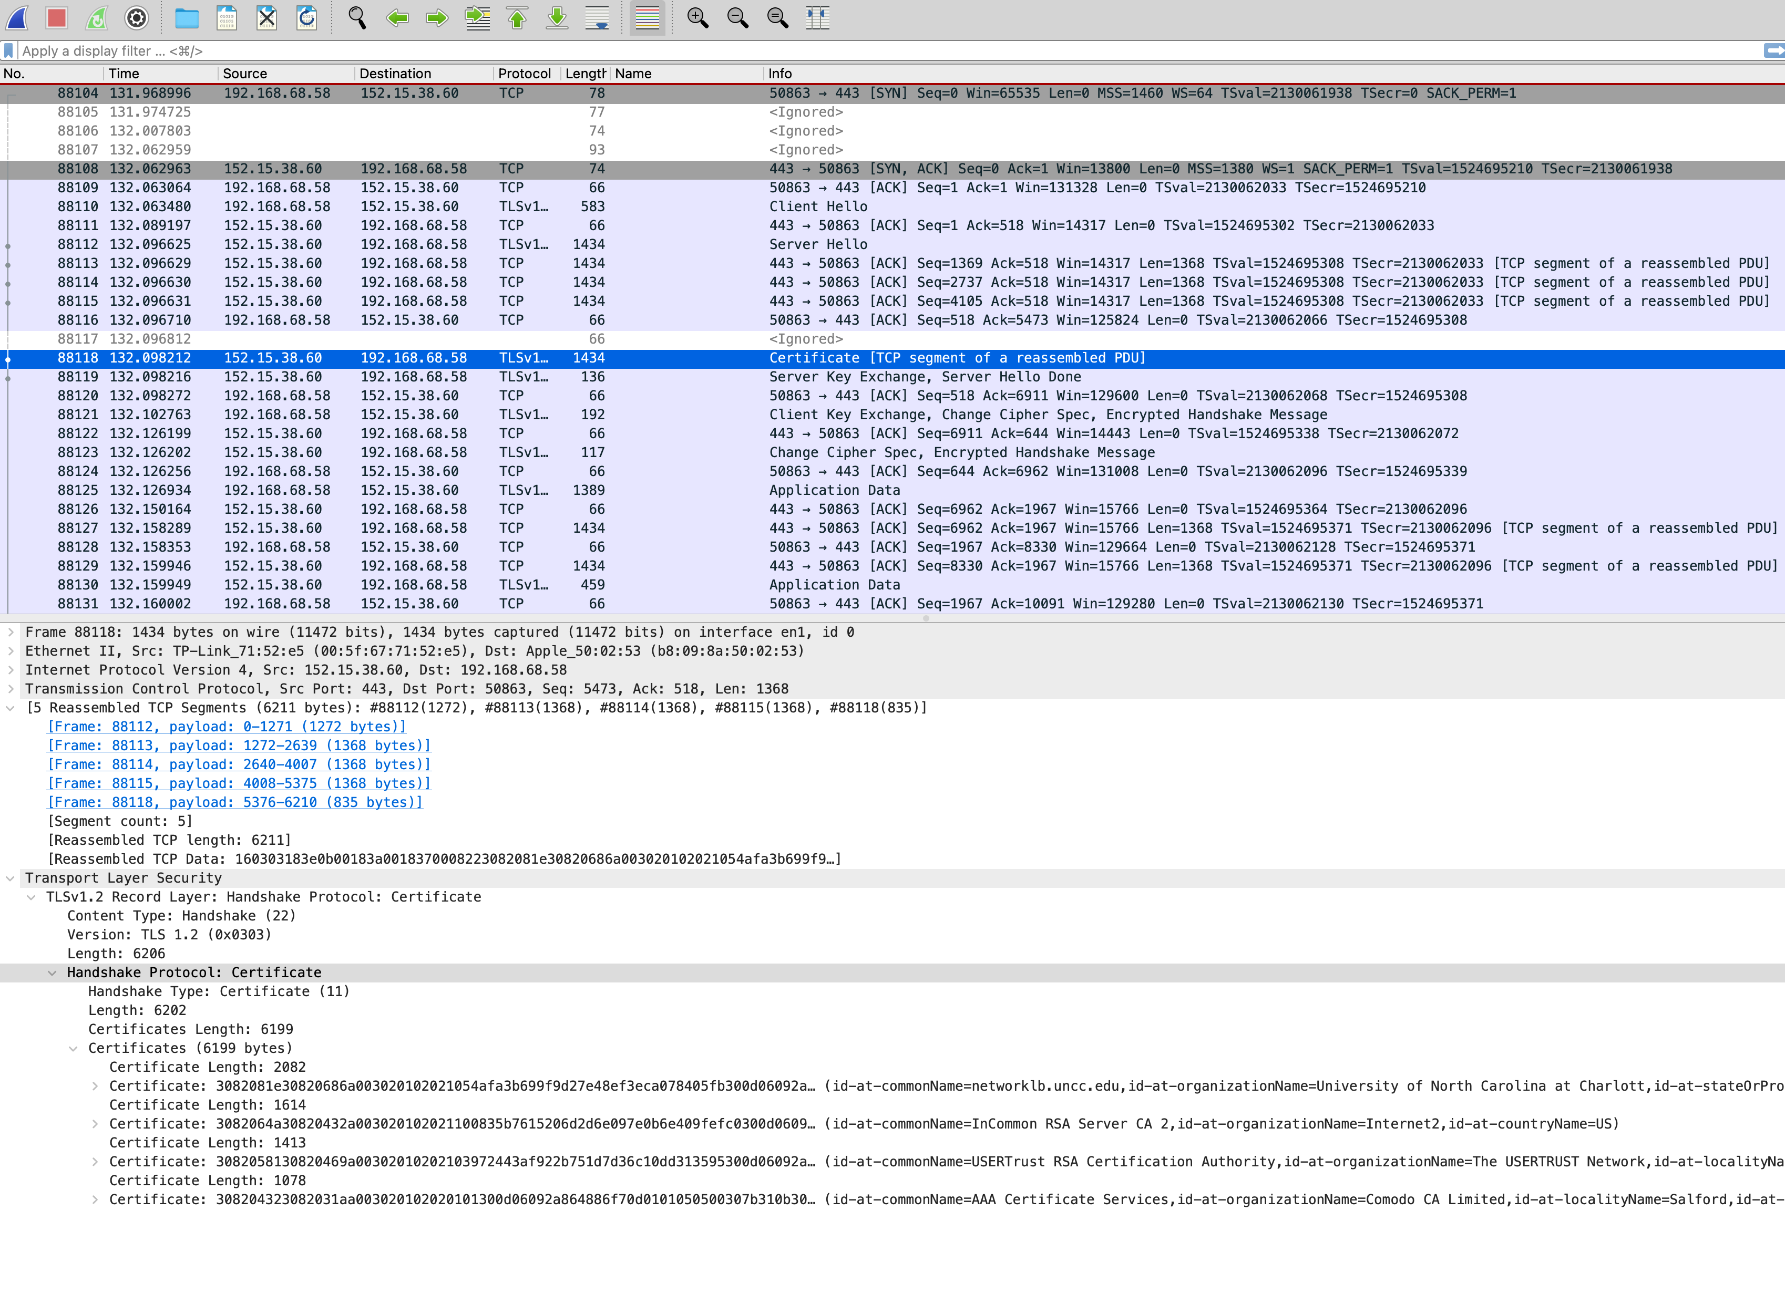
Notes:
1) What is the Client IP address, Server IP address, and their Port numbers?
2) For packet 88118, what will be the sequence number of the next TCP segment sent by the client?
3) According to the fragment reassembling, what is the MTU (maximum transmission unit) of the network, the head size of the TCP packet and the certificate size?

Slide 49
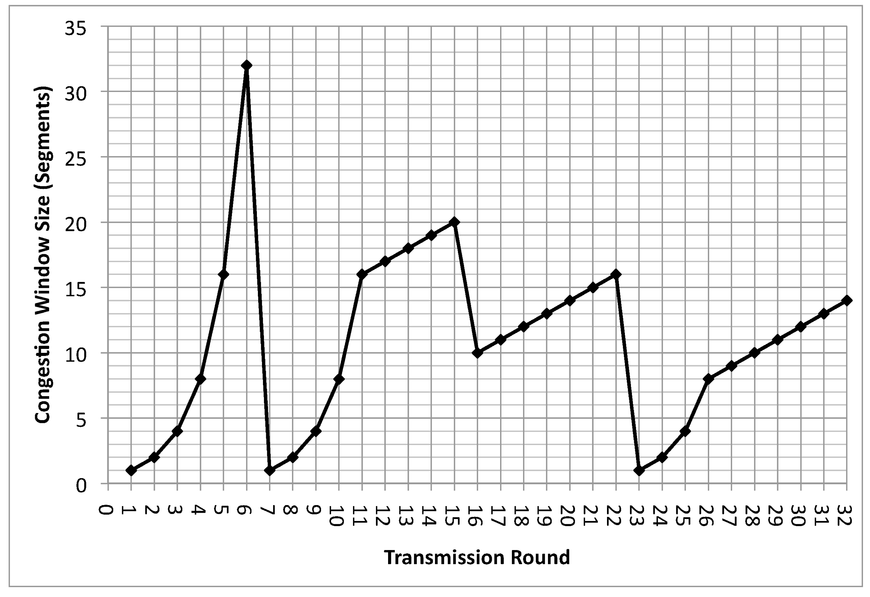
Question
a) Illustrate when timeout events happen in the figure.
b) Compare slow start and congestion avoidance. Give two reasons why slow start is used, and when slow start does a better job.
c) Identify the intervals when slow start is used in the above figure. Identify which of the above reasons apply for each interval, why.
(d) Identify the intervals when congestion avoidance is used. Illustrate why it is used instead of slow start in these intervals.
(e) Identify the intervals when fast retransmission is used. Illustrate why and how it is used.
(f) Identify the intervals when TCP fast recovery is used. Illustrate why and how it is used.

